Slide 1
Error

Slide 2
Type of Errors
The errors caused by a computer program can be categorized into three major groups:
Design-time error
Run- time error
Logic error

Slide 3
Design-Time Error
A design-time error (or, syntax error) occurs when we write a piece of code that does not conform to the rules of the language in which we are writing.
Some syntax errors are simple typographical errors, where we have mistyped a keyword. Others are the result of missing items: undeclared variables, incorrect method call, etc.
A program having design-time errors cannot be compiled and run – we must locate the errors and correct them before continuing.
Any blue-coloured squiggly line represents a design-time error.
To design what the errors are, we need to locate the Task window in the IDE and bring it forward.

Slide 4
Run-Time Error
Run-time errors are harder to locate, because VB.NET does not provide any help in finding run-time errors at design-time.
These errors occur while a program is run.
Examples of run-time errors:
Dividing a number by zero.
Attempting to open a file that does not exist
Entering character data when number is expected.

Slide 5
Logic Error
Logic errors also occur at run-time, when a program does not do what the developer intended it to do.
For example, writing a loop which proceeds to infinity.
Some logic errors may not make a program crash or produce any type of error message. They simply would not perform as intended.
However, some logic errors may make a program crash, at which point the line between a logic error and a runtime error becomes blurry.

Slide 6
Exceptions
A runtime error in VB.NET generates what is called as an exception.
An exception is a response to the error condition that the program just generated.
It is displayed in a dialog box in the form of an exception message.
An error handler is a section of VB.NET code that allows one to detect exceptions and perform the necessary steps to recover from them.
An exception creates an instance of an object, and that object is a descendent of class Exception.

Slide 7
The Try...Catch...Finally Structure
The TRY...CATCH...FINALLY command can be used as a control structure to handle errors, or exceptions, that might occur in our code at run time.
The TRY...CATCH...FINALLY structure begins with the TRY statement, which marks the beginning of the TRY block. In the TRY block, we can specify code that might produce errors at run time.
If our program completes the TRY block without generating an error, or exception, it skips the CATCH block and searches for the FINALLY block near the end of the structure, if it exists, and runs the corresponding statements.
If the FINALLY block does not exist, the program execution continues outside the structure at the first statement following the ENDTRY statement, which marks the end of the TRY...CATCH...FINALLY structure.

Slide 8
Private Sub Button1_click (………………) Handles Button1_click
Dim n as Byte
Try
n = text1.text
Catch
Msgbox(“Sorry – Enter a valid value”)
End Try
End Sub
If any incorrect input is given by the user (e.g. 32767), the error message in a message box is displayed.

Slide 9
Private Sub Button1_click (………………) Handles Button1_click
Dim n as Byte
Try
n = text1.text
Catch ex As Exception
Msgbox(ex.Message)
End Try
End Sub
In this example, the exception generates an instance of the Exception class and places that instance in a variable ex.
If any incorrect input is given by the user, the exception message in a message box is displayed.
For example, if input taken is 32767, the exception message displayed is “Arithmetic operation resulted in an overflow”

Slide 10
The Try...Catch...Finally Structure
Try Statements
Statement(s) where an error can occur. Can be a compound statement.
Catch
Multiple Catch blocks permitted. If an exception occurs while processing the Try block, each Catch statement is examined in textual order to determine if it handles the exception, with exception representing the exception that has been thrown.
Finally
Optional. A Finally block is always executed when execution leaves any part of the Try statement.

Slide 11
Private Sub Button1_click (………………) Handles Button1_click
Dim n, ans As Byte
Try
n = Text1.Text
ans = 2 / n
Catch ex As System.OverflowException
MsgBox("Please Enter a Number other than Zero")
Catch ex As Exception
MsgBox(ex.Message)
End Try
End Sub
We can also write exception handlers that handle different classes of errors.
In the above example, if the number 0 is taken as input, the overflow exception occurs and the error message displayed is “Please Enter a Number other than Zero". But, if we enter a string, the exception message shown is: “Conversion from string “as” to type ‘Byte’ is not valid”.

Slide 12
Private Sub Button1_Click(………………………… ) Handles Button1.Click
Dim n, ans As Byte
Try
n = Text1.Text
ans = 2 / n
MsgBox("Thank You")
Catch ex As System.OverflowException
MsgBox("Please Enter a Number other than Zero")
Catch ex As Exception
MsgBox(ex.Message)
End Try
End Sub
In the above example, if an error occurs, the message “Thank You” will not be displayed. If you want to show this message even if an error occurs, we can place it in the Finally block as shown next.

Slide 13
Private Sub Button1_Click(………………………… ) Handles Button1.Click
Dim n, ans As Byte
Try
n = Text1.Text
ans = 2 / n
Catch ex As System.OverflowException
MsgBox("Please Enter a Number other than Zero")
Catch ex As Exception
MsgBox(ex.Message)
Finally
MsgBox("Thank You")
End Try
End Sub

Slide 14
Throwing One’s Own Exception
We can even throw “our own exceptions”.
For example, if age is taken as an input, an invalid value such as 1500 should generate an error.
The best way to handle this problem is by sending an exception. For this, an exception handler can be written on our own in the program code. This is referred to as “throwing an exception”.

Slide 15
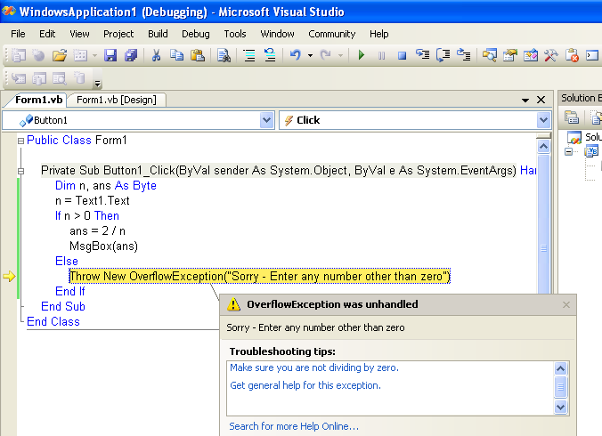

Slide 16
Exception Class | Description
System.IO.IOException | Handles I/O errors.
System.IndexOutOfRangeException | Handles errors generated when a method refers to an array index out of range.
System.ArrayTypeMismatchException | Handles errors generated when type is mismatched with the array type.
System.NullReferenceException | Handles errors generated from deferencing a null object.
System.DivideByZeroException | Handles errors generated from dividing a dividend with zero.
System.InvalidCastException | Handles errors generated during typecasting.
System.OutOfMemoryException | Handles errors generated from insufficient free memory.
System.StackOverflowException | Handles errors generated from stack overflow.

